Slide 1
Presentation on :
AVL TREES
Presented by :pooja pawade

Slide 2
AGENDA
Introduction
Definition
Properties
AVL Tree
AVL Tree Rotations
Operations on AVL Tree
Complexity
Implementation
Advantages and disadvantages
Applications
Summary.

Slide 3
INTRODUCTION:-
AVL trees are height balanced binary search trees. This means the height of the AVL tree is in the order of log(n). AVL tree keeps the height balanced using the following property.
The heights of the left and right subtrees differ by at most 1.
hl be the height of the left subtree and
hr be the height of the right subtree, then,
|hl – hr|≤ 1
Every node should follow the above property and the resulting tree is the AVL tree. If any of the node violates this property, the tree should be re-balanced to maintain the property

Slide 4
Definition
AVL trees are binary search trees in which the difference between the height of the left and right subtree is either -1, 0, or +1.
AVL trees are also called a self-balancing binary search tree. These trees help to maintain the logarithmic search time. It is named after its inventors (AVL) Adelson, Velsky, and Landis.
AVL Tree is invented by GM Adelson - Velsky and EM Landis in 1962.

Slide 5
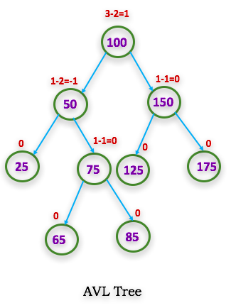
AVL Tree
BF=hl-hr
1
2
7
8
3
4
9
5
6

Slide 6
BF=hl-hr

Slide 7
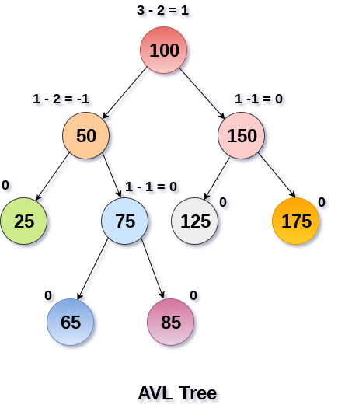
AVL tree:-

Slide 8
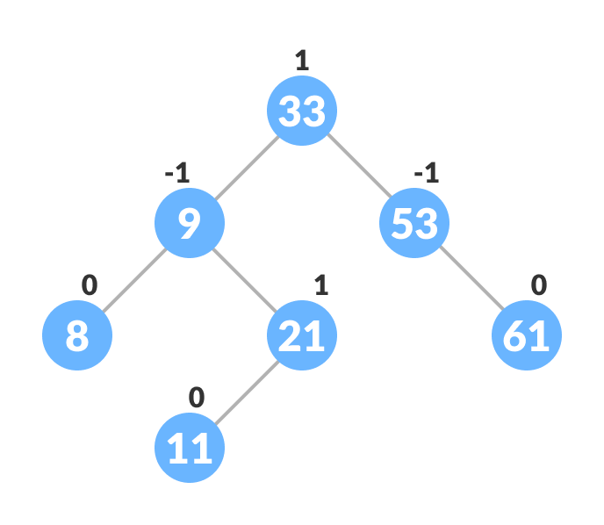
AVL Tree

Slide 9
Properties:
An AVL Tree has the following properties:
AVL Property:
Sub-trees of each node can differ by at most 1 in their height.
Every sub-tree is an AVL Tree.
The total number of nodes in the tree is the sum of the total number of nodes in the left subtree, the total number of nodes in the right subtree and the root node.
N_{h}= N_{h-1} + N_{h-2} + 1

Slide 10
BALANCE FACTOR:-
The balance factor is known as the difference between the height of the left subtree and the right subtree.
Balance factor(node) = height(node->left) – height(node->right)
Allowed values of BF are –1, 0, and +1.
The value –1 indicates that the right sub-tree contains one extra, i.e., the tree is right heavy.
The value +1 indicates that the left sub-tree contains one extra, i.e., the tree is left heavy.
The value 0 shows that the tree includes equal nodes on each side, i.e., the tree is perfectly balanced.

Slide 11
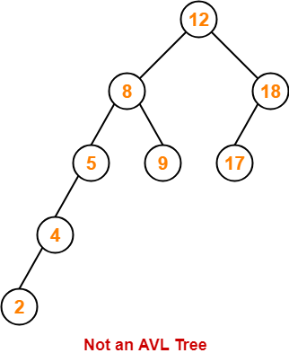
Figure is not an AVL tree as some nodes have balance factor greater than 1.
BF=hl-hr
BF=?
BF=?
BF=?
BF=?
BF=?
BF=?
BF=?
BF=?

Slide 12
Figure is not an AVL tree as some nodes have balance factor greater than 1.
BF=4-2
BF=3-1
BF=1-0
BF=2-0
BF=0-0
BF=0-0
BF=1-0
BF=0-0

Slide 13
Figure is not an AVL tree as some nodes have balance factor greater than 1.
BF=4-2=2
3-1=2
1-0=1
0-0=0
0-0=0
2-0=2
1-0=1
0-0=0

Slide 14
AVL tree rotations:-
When the balance factor of a node is less than -1 or greater than 1, we perform tree rotations on the node. These rotations change the structure of the tree and make the tree balanced. There are four kind of rotations we do in the AVL tree. These are described below.
Left Rotation(LL)
Right Rotation(RR)
Left-Right Rotation(LR)
Right-Left Rotation(RL)

Slide 15
Left Rotation:-
The tree at the left side of Figure is right heavy. To fix this, we must perform a left rotation on node a. This is done in the following steps.
b becomes the new root.
a takes ownership of b’s child as its right child.in this case the value is null.
In AVL tree, we perform the left rotation (LL) on node a.

Slide 16
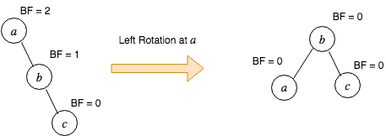
Left rotation ex:-

Slide 17
Pseudocode for left rotation:-
// rotate left at node x void leftRotate(NodePtr x) { NodePtr y = x->right; x->right = y->left; if (y->left != nullptr) { y->left->parent = x; } y->parent = x->parent; if (x->parent == nullptr) { this->root = y; } else if (x == x->parent->left) { x->parent->left = y; } else { x->parent->right = y; } y->left = x; x->parent = y; // update the balance factor x->bf = x->bf - 1 - max(0, y->bf); y->bf = y->bf - 1 + min(0, x->bf); }

Slide 18
Left rotation Pseudocode Ex:-
Left rotation
x
y
Left rotation(t,x)
y
c
a
x
b
c
a
b

Slide 19
Left rotation Pseudocode Ex:-
Left rotation
7
7
x
y
Left rotation(t, x)
4
11
4
18
y
x
18
9
11
19
19
14
22
22
9
14
12
17
20
20
12
17

Slide 20
Right-Rotation(RR):-
We fix the tree on the left side of Figure using following steps.
b becomes the new root node.
c takes ownership of b’s right child, as its left child.in this case the value is null.
In AVL tree, we perform the right rotation (RR) on node c.
Node c is left heavy

Slide 21
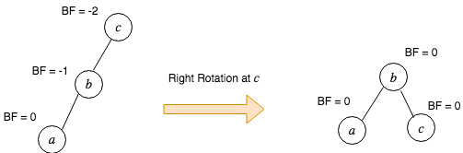
Fig-Right Rotation(RR)
Fig-Right-Right rotation

Slide 22
Pseudocode for right rotation:-
// rotate right at node x
void right Rotate(Node Ptr x) {
Node Ptr y = x->left;
x->left = y->right;
if (y->right != nullptr) {
y->right->parent = x;
}
x->parent = y->parent;
if (x->parent == null ptr) {
this->root = y;
} else if (x == x->parent->right) {
x->parent->right = y;
} else {
x->parent->left = y;
}
y->right = x;
x->parent = y;
// update the balance factor
x->bf = x->bf + 1 - min(0, y->bf);
y->bf = y->bf + 1 + max(0, x->bf);
}

Slide 23
Right rotation Pseudocode Ex:-
Right rotation
y
x
c
Right rotation
a
y
x
b
a
b
c

Slide 24
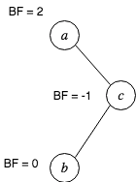
Left- Right Rotation(LR):-
Sometimes a single rotation is not sufficient to balance an unbalanced tree. Consider a tree given in Figure
Fig : An unbalanced tree. Node a is right heavy with BF 2.

Slide 25
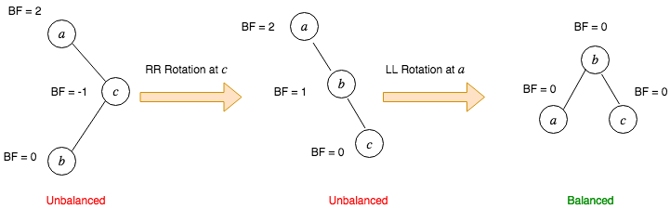
Fig:- illustrating left-right tree
Fig: illustartingthe left-right rotation
We perform the left right rotation (LR) on node a when
Node a is right heavy
Node a’s right subtree .

Slide 26
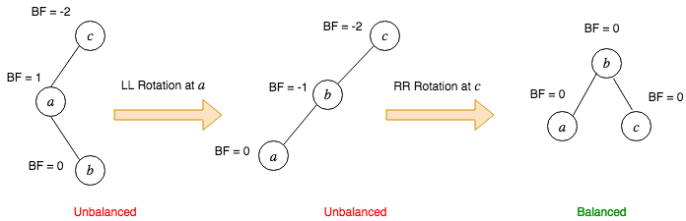
Right-Left rotation(RL):-
RL rotation is symmetric to LR rotation. In RL rotation, we do the following
Perform the left rotation on the left subtree.
Perform the right rotation on the root node.
This is illustrated in Figure
Fig : Illustrating the right-left rotation

Slide 27
Cont:-
We perform the right left rotation (LR) on node a when,
Node c is left heavy
Node c is left subtree is right heavy

Slide 28
Operations on AVL tree
AVL tree supports all the dynamic set operations. In this post, I am going to discuss about insertion and deletion operations only. The rest of the operations are similar to the ordinary binary search tree .
Insertion:-
To insert a node x on an AVL tree, we do the following.
Insert node x using the ordinary binary search tree insertion logic.
Update the balance factors of all the ancestral nodes of x
If the balance factor is other than -1, 0, 1, balance the tree using the tree rotations.

Slide 29
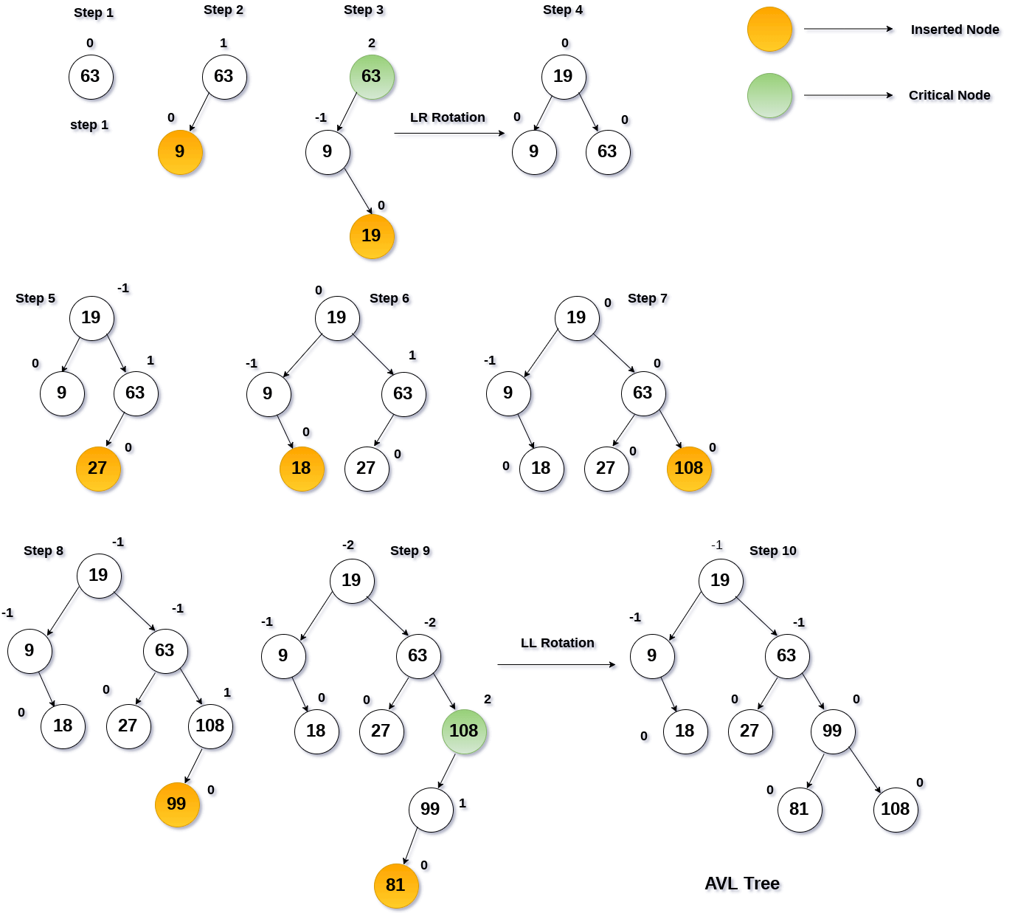
Insertion in AVL Tree example:-
Ex:-63,9,19,27,18,108,99,81.

Slide 30
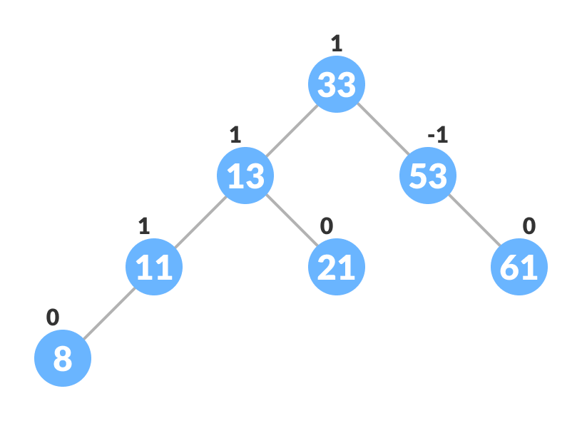

Algorithm To Insert a New Node
1. A newNode is always inserted as a leaf node with balance factor equal to 0.
Let the initial tree be

Slide 31
Cont:-
2.Go to the appropriate leaf node to insert a newNode using the following recursive steps.
a.Compare newKey with rootKey of the current tree.
b. If newKey < rootKey, call insertion algorithm on the left subtree of the current node until the leaf node is reached.
c. Else if newKey > rootKey, call insertion algorithm on the right subtree of current node until the leaf node is reached.
d. Else, return leaf Node

Slide 32
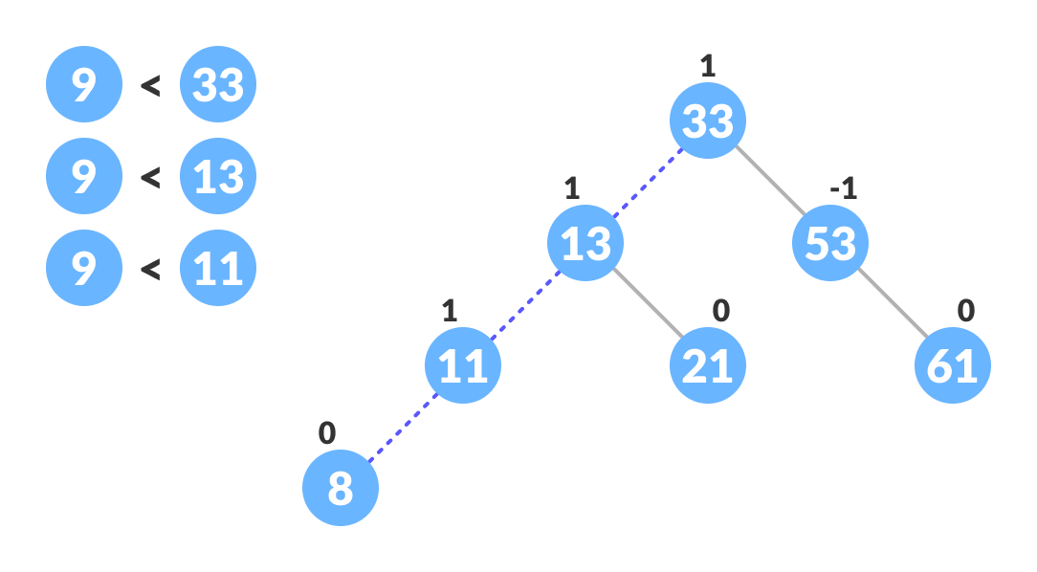
Cont:

Slide 33
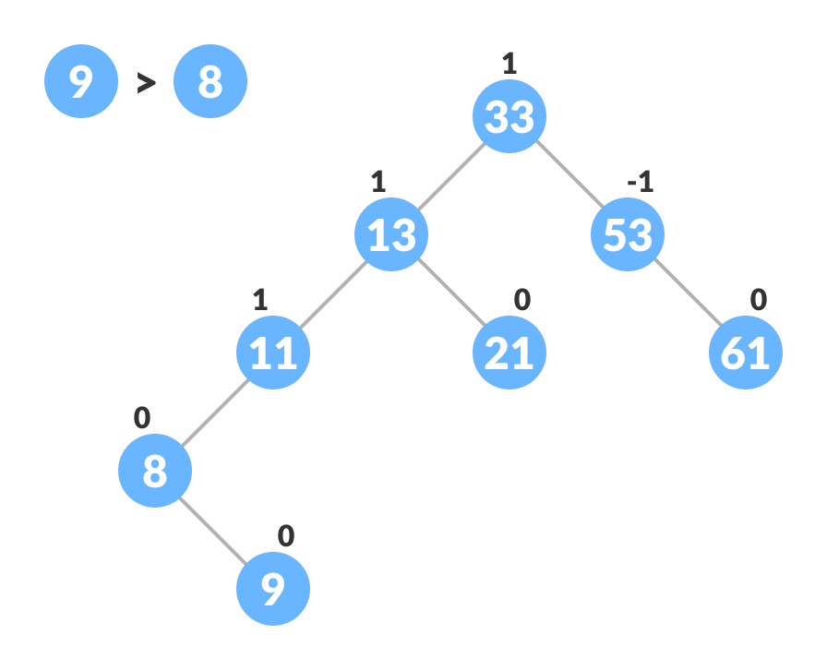
Cont:-
3.Compare leafKey obtained from the above steps with newKey
If newKey < leafKey, make newNode as the leftChild of leafNode.
Else, make newNode as rightChild of leafNode.

Slide 34
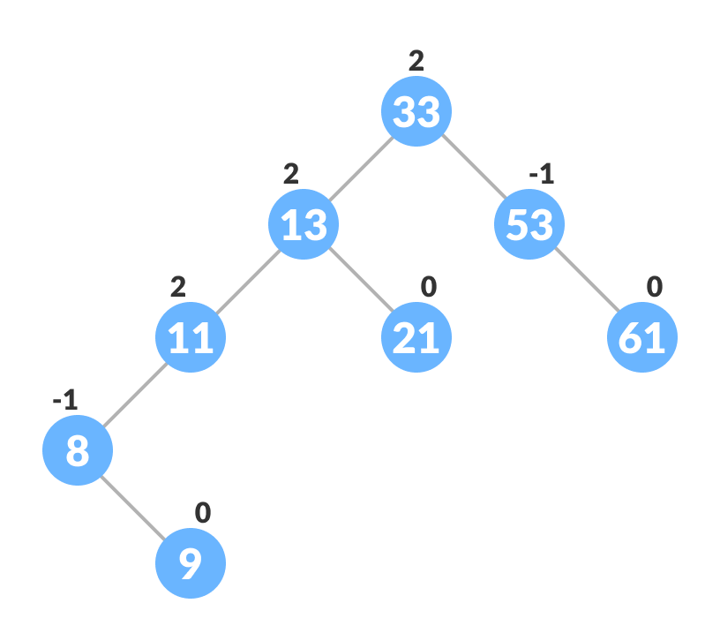
4.Update balanceFactor of the nodes
Update balance factor of the nodes.
BF=hl-hr

Slide 35
Cont:
5.If the nodes are unbalanced, then rebalance the node. If balanceFactor > 1, it means the height of the left subtree is greater than that of the right subtree. So, do a right rotation or left-right rotation
If newNodeKey < leftChildKey do right rotation.
Else, do left-right rotation

Slide 36
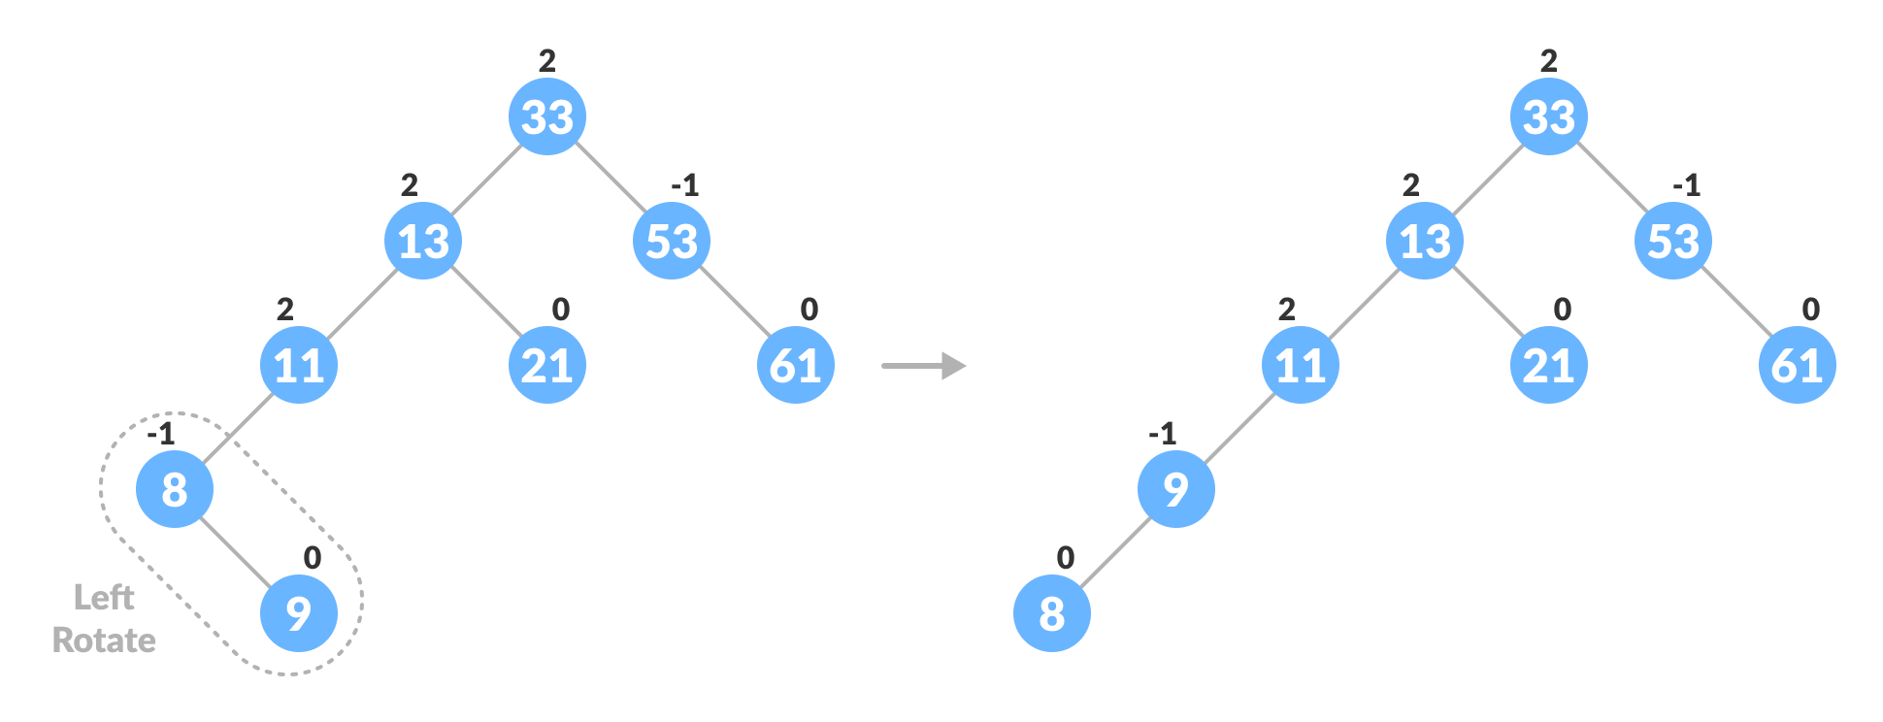
Ex:-
Left-Right rotation:-

Slide 37
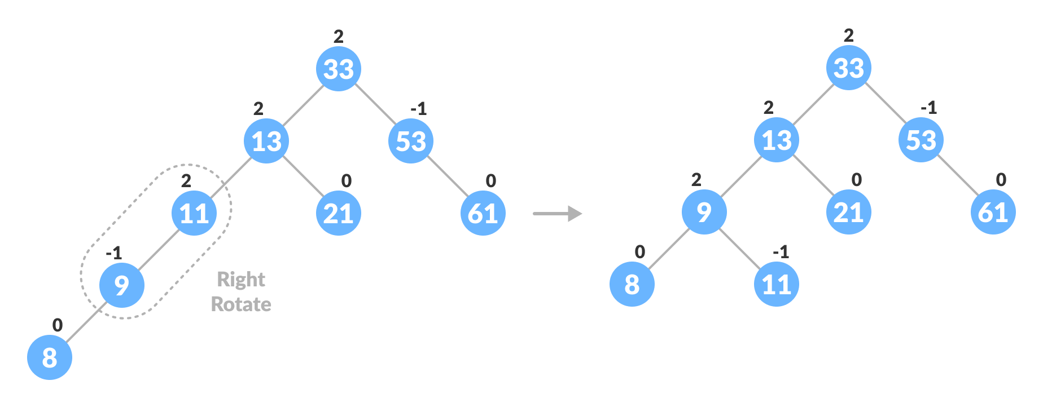
b. if balanceFactor < -1, it means the height of the right subtree is greater than that of the left subtree. So, do right rotation or right-left rotation If newNodeKey > rightChildKey do left rotation. Else, do right-left rotation

Slide 38
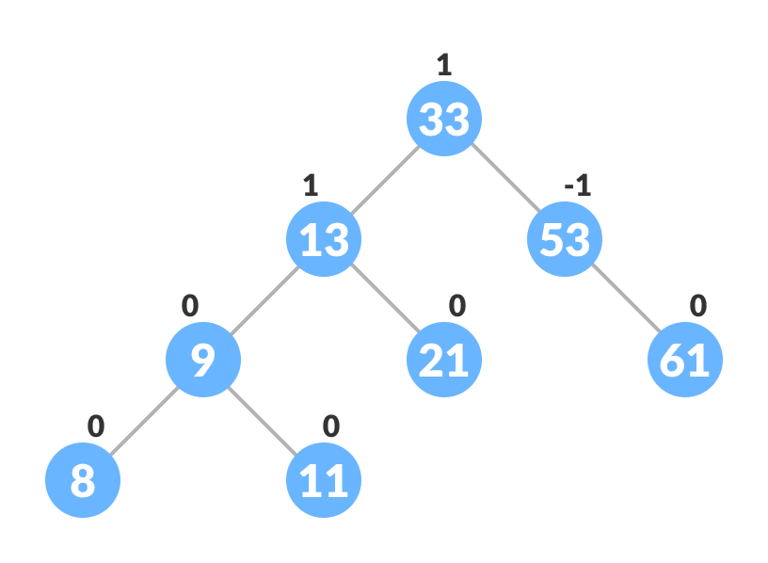
The final tree is:

Slide 39
PSEUDOCODE FOR INSERTION
INSERT(T, n)
temp = T.root
y = NULL
while temp != NULL
y = temp
if n.data < temp.data
temp = temp.left
else
temp = temp.right
n.parent = y
if y==NULL
T.root = n
else if n.data < y.data
y.left = n
else
y.right = n

Slide 40
z = n
while y != NULL
y.height = 1 + MAX(HEIGHT(y.left), HEIGHT(y.right))
x = y.parent
if BALANCE-FACTOR(x) <= -2 or BALANCE-FACTOR(x) >= 2 //grandparent is unbalanced
if y == x.left
if z == x.left.left //case1
RIGHT_ROTATE(T, x)
else if z == x.left.right //case 3
LEFT_ROTATE(T, y)
RIGHT_ROTATE(T, x)

Slide 41
RIGHT_ROTATE(T, x)
else if y == x.right
if z == x.right.right //case 2
LEFT_ROTATET(T, x)
else if z == x.right.left //case 4
RIGHT_ROTATE(T, y)
LEFT_ROTATE(T, x)
break
y = y.parent
z = z.parent

Slide 42
Deletion:
Deletion operation is same as the insertion operation. To delete a node x from the AVL tree, we first delete it using the ordinary binary search tree deletion logic.
After that we update the balance factor of the ancestral node of x and perform the tree rotation if the tree is unbalanced.

Slide 43
Algorithm to Delete a node
A node is always deleted as a leaf node. After deleting a node, the balance factors of the nodes get changed. In order to rebalance the balance factor, suitable rotations are performed.
Locate node To Be Deleted.

Slide 44
Cont:-
2.There are three cases for deleting a node:
a.If node To Be Deleted is the leaf node (ie. does not have any child), then remove node To Be Deleted.
b. If node To Be Deleted has one child, then substitute the contents of nodeToBe Deleted with that of the child. Remove the child.
c. If node To Be Deleted has two children, find the inorder predecessor of node To Be Deleted (ie. node with a maximum value of key in the leftt subtree). Substitute the contents of node To Be Deleted with that node.

Slide 45
Cont:-
3.Rebalance the tree if the balance factor of any of the nodes is not equal to -1, 0 or 1.
a. If balance Factor of current Node > 1,
b. If balance Factor of left Child >= 0, do right rotation.
4.Update balance Factor of the nodes.
a. Else do left-right rotation.

Slide 46
Cont:-
b. If balance Factor of current Node < -1,
c. If balance Factor of right Child <= 0, do left rotation.
d. Else do right-left rotation.
5.The final tree .

Slide 47
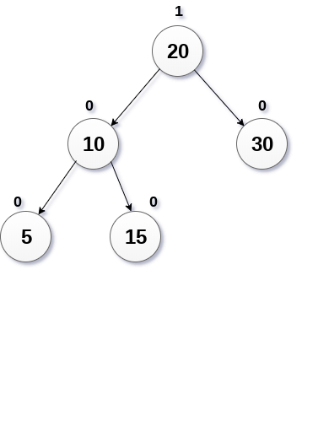
Example of deletion :-
Delete the node 30 from the AVL tree shown in the following image.

Slide 48
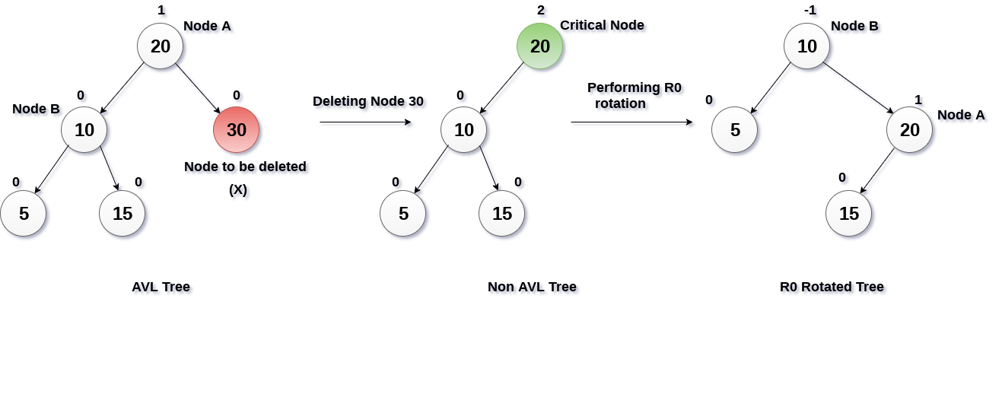

Slide 49
Deletion in avl tree:-
Ex:-8,7,11,14,17
14
1.Locate node To Be Deleted.
11
19
7
12
17
53
4
8
13
16
20
60

Slide 50
Deletion in avl tree:-
->There are three cases for deleting a node: Case1:-If node To Be Deleted is the leaf node (ie. does not have any child), then remove node To Be Deleted.
Ex:-8,7,11,14,17
14
11
19
7
12
17
53
4
8
13
16
20
60

Slide 51
Deletion in avl tree:-
BF=hl-hr
Ex:-8,7,11,14,17
0
14
0
Case2:- If node To Be Deleted has one child, then substitute the contents of node To Be Deleted with that of the child. Remove the child.
0
11
19
1
-1
1
0
7
12
17
53
0
0
0
0
0
4
13
16
20
60

Slide 52
Deletion in avl tree:-
Case 3:-If node To Be Deleted has two children, find the inorder predecessor of node To Be Deleted (ie. node with a maximum value of key in the leftt subtree).
Ex:-8,7,11,14,17
0
14
0
-1
11
19
-1
1
0
0
53
4
12
17
c. Substitute the contents of node To Be Deleted with that node.
0
0
0
0
13
16
20
60

Slide 53
Deletion in avl tree:-
Ex:-8,7,11,14,17
0
If balance Factor of right Child <= 0, do left rotation.
14
0
-2
4
19
1
0
-1
53
12
17
0
0
0
0
13
16
20
60

Slide 54
Deletion in avl tree:-
c. If node To Be Deleted has two children, find the inorder predecessor of node To Be Deleted (ie. node with a maximum value of key in the leftt subtree).
Ex:-8,7,11,14,17
-1
14
0
0
12
19
1
0
0
0
53
4
13
17
0
0
0
16
20
60

Slide 55
Deletion in avl tree:-
Case1:- If node To Be Deleted has one child, then substitute the contents of node To Be Deleted with that of the child. Remove the child.
Ex:-8,7,11,14,17
-1
13
0
1
12
19
1
0
0
53
4
17
0
0
0
16
20
60

Slide 56
Deletion in avl tree:-
The final tree:-
Ex:-8,7,11,14,17
-1
13
BF=hl-hr
-1
1
12
19
0
0
0
53
4
16
0
0
20
60

Slide 57
Complexity:-
The running time of all the operations in AVL tree is O(logn). This is because AVL tree guarantees the height of the tree is always in the order of logn.

Slide 58
Implementation:-
The AVL tree node has the following properties.
data: It contains the key of the node
parent: It contains the reference to the parent node.
left: It contains the reference to the left subtree.
right: It contains the reference to the right subtree.
bf: It contains the balance factor of the node. This is the additional property in the AVL tree which is not present in ordinary BST

Slide 59
Advantages And Disadvantages of AVL Trees
Advantages:-
The height of the AVL tree is always balanced. The height never grows beyond log N, where N is the total number of nodes in the tree.
It gives better search time complexity when compared to simple Binary Search trees.
AVL trees have self-balancing capabilities.
Disadvantages :-
AVL Trees have high constent factors for some oprations.
AVL Tree are difficult to implement.

Slide 60
AVL Tree Applications
AVL Tree are used in database applications.
Manipulate sorted lists of data.
Manipulate hierchical data.

Slide 61
summary:
AVL trees are self-balancing binary search trees.
Balance factor is the fundamental attribute of AVL trees
The balance factor of a node is defined as the difference between the height of the left and right subtree of that node.
The valid values of the balance factor are -1, 0, and +1.
The insert and delete operation require rotations to be performed after violating the balance factor.

Slide 62
The time complexity of insert, delete, and search operation is O(log N).
AVL trees follow all properties of Binary Search Trees.
The left subtree has nodes that are lesser than the root node. The right subtree has nodes that are always greater than the root node.
AVL trees are used where search operation is more frequent compared to insert and delete operations

Slide 63
PSEUDOCODE FOR DELETION
DELETE(T, z)
if z.left == NULL
TRANSPLANT(T, z, z.right)
if z.right != NULL
AVL_DELETE_FIXUP(T, z.right)
elseif z.right == NULL
TRANSPLANT(T, z, z.left)
if z.left != NULL
AVL_DELETE_FIXUP(T, z.left)

Slide 64
Else
y = MINIMUM(z.right) //minimum element in right subtree
if y.parent != z //z is not direct child
TRANSPLANT(T, y, y.right)
y.right = z.right
y.right.parent = y
TRANSPLANT(T, z, y)
y.left = z.left
y.left.parent = y
if y != NULL
AVL_DELETE_FIXUP(T, y)

Slide 65
THANK YOU!

